Slide 1


Properties of Sound
Tri-Service Hearing Technician
4.2 Certification Course

Slide 2
Properties of Sound
Learning Objectives
1.4.1 Understand the definitions of sound, noise, frequency, intensity
1.4.2 Explain the physical properties of sound
1.4.3 Explain the requirements for a sound, sound transmissions
1.4.4 Explain the characteristics of sound
1.4.5 Understand the 3 foot rule
1.4.6 Understand the Inverse Square Law
1.4.7 Understand doubling of sound sources
Tri-Service Hearing Technician 4.2 Certification Course

Slide 3
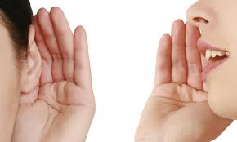
Properties of Sound
Definitions
Sound
  Any pressure change in air, water or other medium
  Scientific definition - pressure change or vibration that is propagated in a medium
  Informal definition - perception resulting from stimulation of the auditory mechanism
Noise
  Unwanted sound
  Varies from person to person
Tri-Service Hearing Technician 4.2 Certification Course
Notes:
Noise: Any unwanted sound that is irritating or interferes with an activity.
(Image: http://benefitof.net/six-amazing-benefits-of-active-listening-to-both-speaker-and-the-listener/)

Slide 4
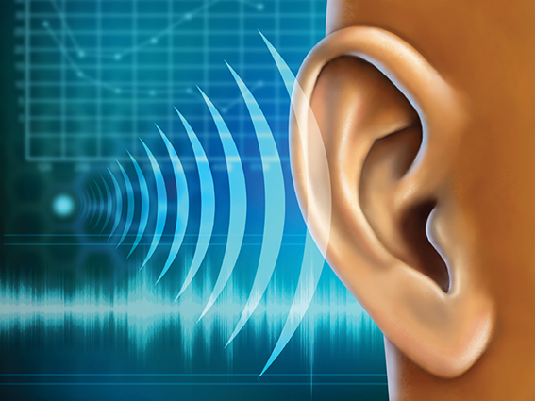
Properties of Sound
Requirements for Sound
Sender (Source)
Vibrating body
Medium
Receiver
Tri-Service Hearing Technician 4.2 Certification Course
Notes:
Requirements for sound propagation: Sender – the source of vibration or energy; Vibrating body; Medium – what carries the vibration (the sound wave pathway); Receiver – the auditory mechanism
(Image: http://www.pixword.net/answers/10-Letters/id-2443.html)

Slide 5
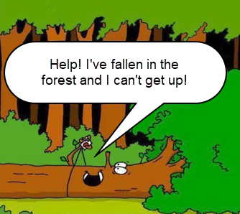
Properties of Sound
If a tree falls in the woods…
…and there is no one there to hear it, is there sound?
Tri-Service Hearing Technician 4.2 Certification Course

Slide 6
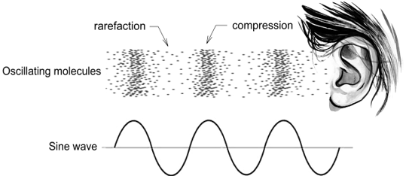
Properties of Sound
Transmission of Sound
Vibration: alternating pressure changes in air molecules
  Compression
  Rarefaction
Sound wave = compression + rarefaction
  One complete cycle is one set of compression and rarefaction
Tri-Service Hearing Technician 4.2 Certification Course
Notes:
Vibration: a sound source (sender) causes alternating pressure changes in the air molecules (medium).
Compression: molecules are forced together causing areas of high (positive) pressure; the medium becomes compressed.
Rarefaction: molecules separate from each other causing areas of low (negative) pressure; the medium becomes more spread out.
Sound wave: a series of pressure changes in compression and rarefaction cycles that transfer energy.
(Image: http://www.midichords.com/posts/the-first-condition-for-making-music-is-not-to-make-a-noise)

Slide 7
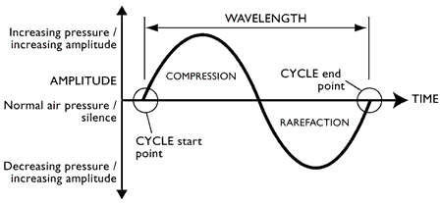
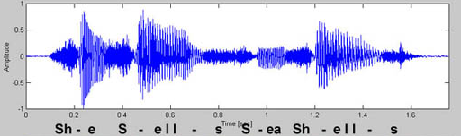
Properties of Sound
Transmission of Sound
Sine Waves - simplest sounds
  Pure Tone - simplest form of sound
Complex Sounds
Tri-Service Hearing Technician 4.2 Certification Course
Notes:
Sine Wave – Graphic representation of the simplest sound wave, which is a single frequency, or a pure tone, of constant intensity.
Complex Sounds - A complex sound wave consists of many frequencies of varying intensities; most of the sounds in our environment are complex sounds.
Horizontal Axis – represents time in seconds
Vertical Axis - Represents molecule vibrations
Compression - Upward movement indicating a rise in pressure
Rarefaction - downward movement indicating a drop in pressure
Cycle - 1 complete compression + 1 complete rarefaction
(Image: http://www.planetoftunes.com/sound-audio-theory/sound-waveform-diagrams.html)

Slide 8
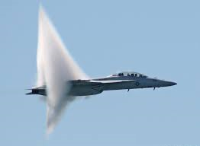
Properties of Sound
Transmission of Sound
Gas
  Air = 1,100 feet/second
Liquid
  Water = 4,500 feet/second
Solid
  Steel = 15,000 feet/second
Tri-Service Hearing Technician 4.2 Certification Course
Notes:
Speed of sound waves; the velocity (speed) at which a sound wave travels depends on the medium; the denser the medium the faster the sound waves travel.
(Image: http://www.wisegeek.com/what-is-the-sound-barrier.htm)

Slide 9
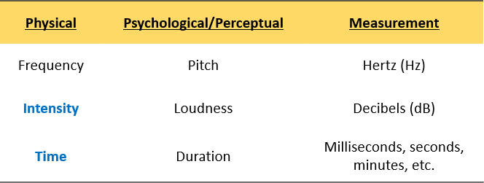
Properties of Sound
Characteristics of Sound
The 2 parameters of sound that make noise hazardous are Intensity and Time
Tri-Service Hearing Technician 4.2 Certification Course

Slide 10
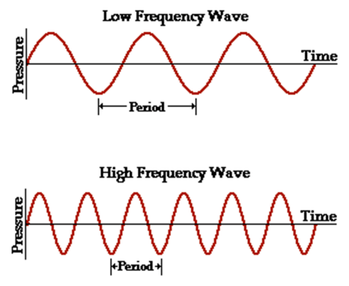
Properties of Sound
Frequency (Pitch)
Measured in Hertz (Hz)
  The number of cycles per second
  The more cycles per second, the higher the frequency
Audio Testing Frequencies
  500 Hz, 1000 Hz, 2000 Hz, 3000 Hz, 4000 HZ, 6000 Hz
  8000 Hz (optional)
Tri-Service Hearing Technician 4.2 Certification Course
Notes:
Frequency - the number of cycles per second, expressed in Hertz (Hz) as the unit of measurement. Pitch is the psychologic perception of frequency. The more cycles per second, the higher in pitch the sound.
(Image: https://www.researchgate.net/figure/241267596_fig10_Figure-215-Difference-between-high-and-low-frequency-sound-waves-21)

Slide 11
Properties of Sound
Frequency (Pitch)
Total range of human hearing at birth
  20 Hz - 20,000 Hz
Speech range
  250 Hz - 4000 Hz
  Consonants - higher frequency
  Vowels - lower frequency
Noise damage
  3000 Hz - 6000 Hz
Most sensitive area of sound detection in humans
  1000 Hz - 4000 Hz
Tri-Service Hearing Technician 4.2 Certification Course
Notes:
Human hearing is less sensitive in the low frequencies.
DOEHRS-HC testing range: 500 Hz, 1000 Hz, 2000 Hz, 3000 Hz, 4000 Hz, 6000 Hz; 8000 Hz is optional, but recommended
If students are taking the CAOHC test, they need to remember all information on this slide

Slide 12
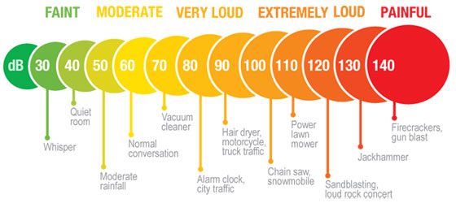
Properties of Sound
Intensity (Loudness)
The amplitude of a sound wave
Measured in decibels (dB)
Decibels are used instead of pressure units to keep the numbers in a manageable range
Decibels are logarithmic, not arithmetic
Tri-Service Hearing Technician 4.2 Certification Course
Notes:
Intensity: the loudness of a sound results from the amount of pressure or energy exerted on materials or surfaces they encounter; unit of measurement is decibels (dB).
Description of everyday sounds in decibels, noise levels are approximate and should only be used as a guide
(Image: http://www.hearingandaudiology.com.au/about-us/blog/2015/april/app-that-measures-noise.aspx)

Slide 13
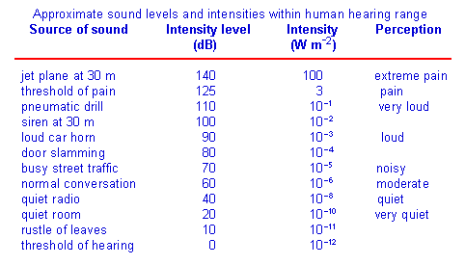
Properties of Sound
Intensity
Tri-Service Hearing Technician 4.2 Certification Course
Notes:
Decibels are a logarithmic representation of the intensity of a sound.
Dynamic range of intensity in human: 0.00002 Pascal (threshold of normal hearing) – 20 Pascal (threshold of pain)
(Image: https://www.slideshare.net/ProudParas/sound-waves-loudness-and-intensity)

Slide 14
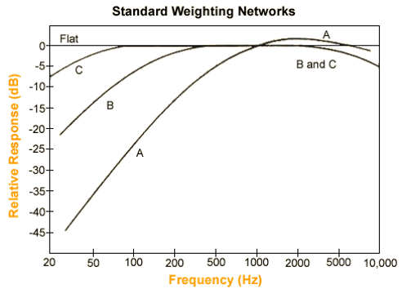
Properties of Sound
Types of Decibels
  dB SPL - Sound Pressure Level
Weighting scales
  dB A - continuous noise (mimics the response of the human ear in sensitivity and potential damage from noise hazards)
  dB C - continuous or impulse noise (includes low frequency energy)
    Used to determine HPD Noise Reduction Rating (NRR)
  dB P - continuous, impulse, or impact noise
    Sound duration less than 1 second
Tri-Service Hearing Technician 4.2 Certification Course
Notes:
dB SPL – Sound Pressure Level. The amount of sound energy in the atmosphere around us.
DB SPL is also considered dB F (flat), without weighting.
Common weighting-scales used in hearing conservation:
dB A – Used by IH professional when measuring shop noise; attempts to mimic the response of the human ear in sensitivity and potential damage from noise hazards
dB A weighting closely correlates with risk of noise-induced hearing loss
dB C – Used by IH professional when measuring shop noise with sufficient low frequency energy and used to measure the noise reduction rating (NRR) of hearing protectors, depending on the measurements used
dB P – Used by IH professional when measuring impact/impulse noise (Image: https://www.ocn.org.au/guide/244-weighting-dba-and-c-weighting-dbc)

Slide 15
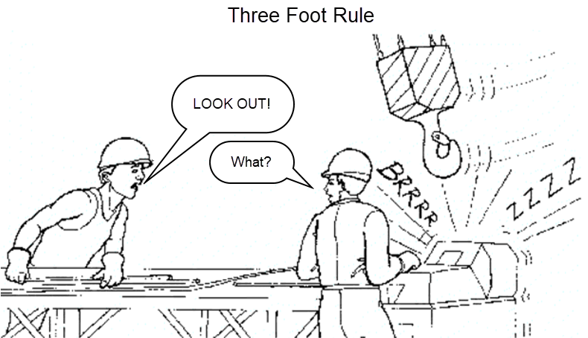
Properties of Sound
Intensity
Tri-Service Hearing Technician 4.2 Certification Course
Notes:
How to know if you are in potentially loud hazardous noise?
Three Foot Rule: If you need to raise your voice or shout to be understood from three feet away from someone, you are probably in a hazardous noise environment.
Rule of thumb to use with workers/patients to judge the noise hazard in their environment.
(Image: http://training.itcilo.it/actrav_cdrom2/en/osh/noise/nomain.htm)

Slide 16
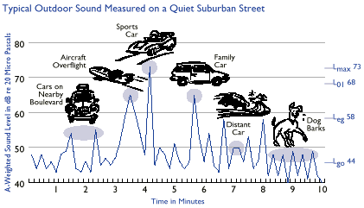
Properties of Sound
Duration
  The length of time that sound is present
Types
  Continuous
    Intermittent
    Varying
  Impulse
  Impact
Tri-Service Hearing Technician 4.2 Certification Course
Notes:
Duration length of time that sound is present
Continuous or steady-state noise – lasts more than 2 seconds
Intermittent noise – large differences in sound levels occurring with periodic interruptions of relative quiet between noise episodes
Varying – when the noise level varies but there are no significant quiet periods
Impulse noise – very short bursts of noise lasting less than one second in duration (e.g., gunshot)
Impact noise – slightly longer than impulse (e.g., metal stamping)
(Image: http://www.nonoise.org/library/envarticle/; https://www.arl.army.mil/www/default.cfm?page=352)

Slide 17
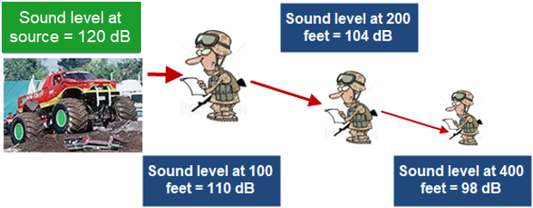
Properties of Sound
Inverse Square Law
Attenuation by distance
Double distance = intensity decrease by 6 dB
Tri-Service Hearing Technician 4.2 Certification Course
Notes:
Dynamics of Sound Transfer: Double the distance from a noise source, decrease the amount of intensity by 6 dB

Slide 18
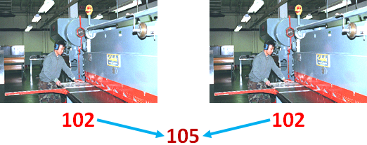
Properties of Sound
Combining Sound Sources
Double the noise source = increase noise level by 3 dB
Tri-Service Hearing Technician 4.2 Certification Course
Notes:
Dynamics of Sound Transfer:
Combining sound sources that are the same: For each doubling of the noise source, the intensity will increase by 3 dB
Cannot add the dB levels together, due to logarithmic nature of decibels

Slide 19
Properties of Sound
Summary
Definitions of sound, noise, frequency, intensity
Physical properties of sound
Requirements for a sound, sound transmissions
Characteristics of sound
  Frequency/Pitch (Hz)
  Intensity/Loudness (dB)
3 foot rule
Inverse Square Law
Doubling of sound sources
Tri-Service Hearing Technician 4.2 Certification Course

Slide 20
Properties of Sound
? Questions ?
Tri-Service Hearing Technician
4.2 Certification Course

